Slide 1
Using AI to Prepare for Moot Court
2025 LWI Online AI Conference: AI & Legal Skills: Innovation, Impact, & Integrity
Jayne Woods, University of Missouri School of Law

Slide 2
Background
Set in federal court
Book in elementary school library
Numerous parent complaints that book advocates anti-vax ideology
School restricts access (parent approval required)
Justifications:
Demonstrably false
Conflicts with district curriculum standard regarding role of vaccines
summary judgment granted to school district; students appeal
Notes:
First a little background on the problem we used. It involved the book Melanie’s Marvelous Measles. This book was in an elementary school library but, following numerous parent complaints that it espoused anti-vaccine ideology, the school board decided to restrict access to only those students with parent approval. Some students filed suit claiming the restriction violated their first amendment right to receive information and ideas. The school argued that the book was removed for legitimate pedagogical concerns, specifically that it contained demonstrably false information and conflicted with the district curriculum standard regarding the role of vaccines. For our moot court, SJ was granted to the school and the students appealed.

Slide 3
Seven steps*
Update your brief
Understand procedural standard at trial and standard of review on appeal
Revisit or revise your theory of the case and theme
Choose the most important points to raise
Prepare an outline
Generate questions
Practice
*Stetson Univ. Inst. for Advancement of Leg. Commc’n et al., Oral Argument: The Essential Guide (2018).
Notes:
When teaching students how to prep, we use Stetson’s Oral Argument guide, specifically these seven steps. Today, I’m going to focus on the last three.

Slide 4
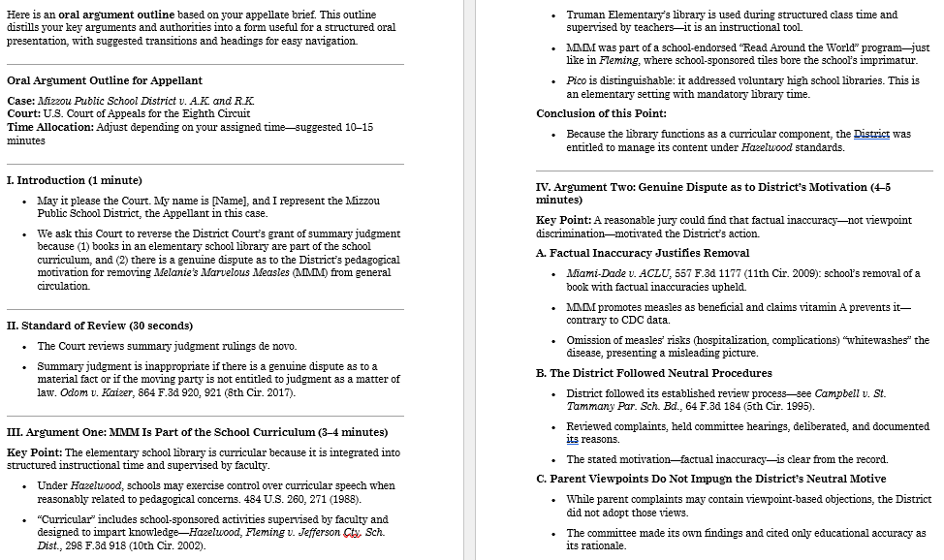
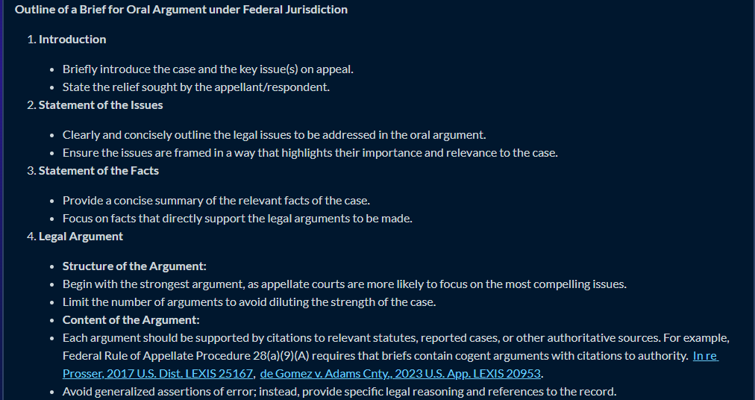
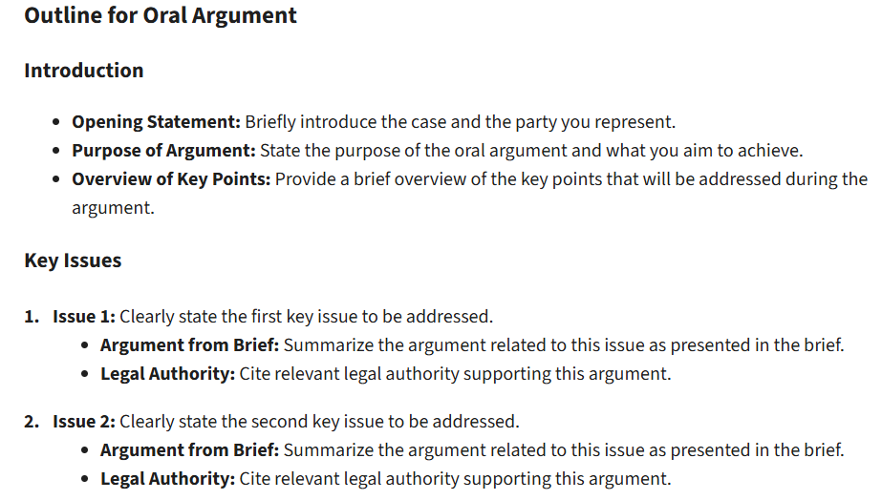
Prepare an outline
Notes:
First, I suggest to the students that they upload their brief into an AI and ask it to create an outline for oral argument. This is the ChatGPT version. I tried this through both CoCounsel and Protégé and was severely disappointed, as both failed to incorporate the actual brief from the case and instead used generalities.

Slide 5
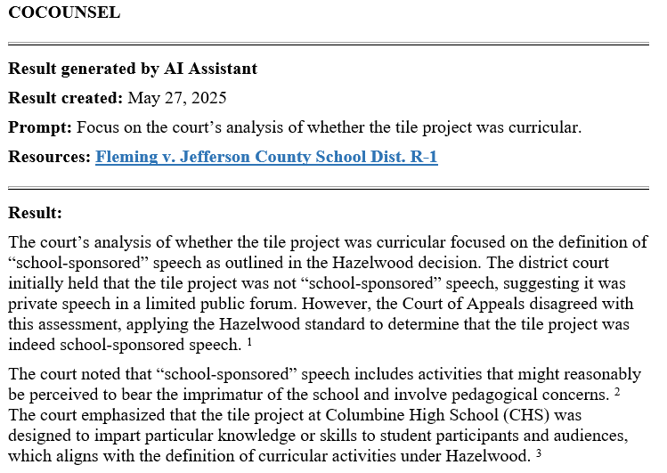
Case Summaries
Notes:
I also suggest they have case summaries at hand for the most relevant decisions. And CoCounsel excelled at this, especially when asked to home in on specific legal issues.

Slide 6
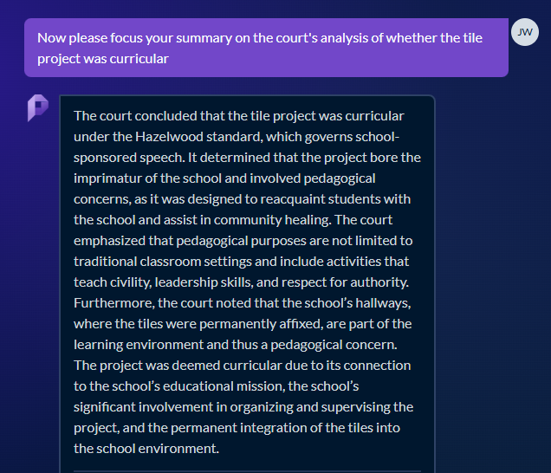
Case Summaries
Notes:
Protégé also does well in this area, but both legal platforms tend to provide legal conclusions without specific focus on the facts

Slide 7
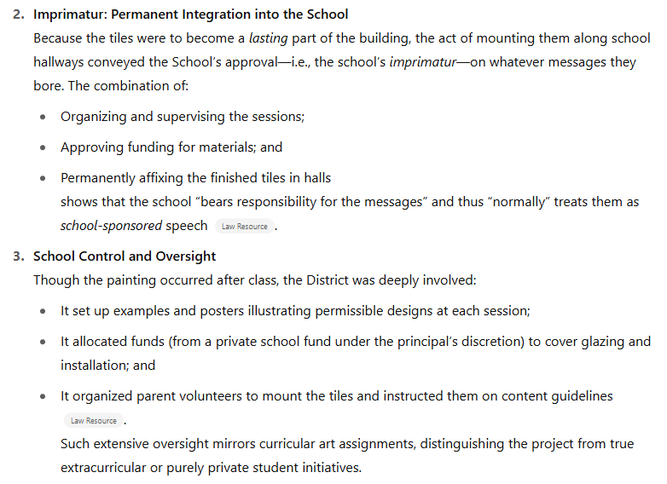
Case Summaries
* * *
Notes:
ChatGPT on the other hand is a lot more fact specific. This result was without me providing the actual case to the AI; the analysis improved when I gave it a pdf of the actual case

Slide 8
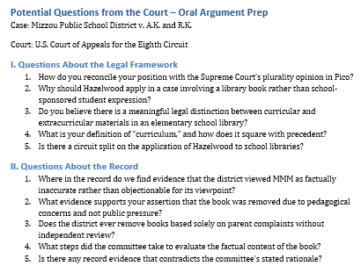
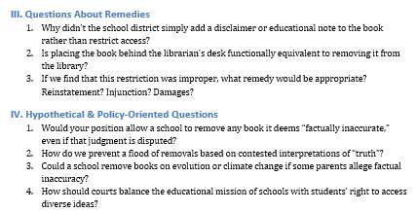
Generate Questions
Notes:
I also suggest to the students that they ask the AI to suggest a list of questions that an appellate judge might ask at oral argument. This is again from ChatGPT, based on the provided brief. CoCounsel was more helpful here than it was with the outline, but—unlike ChatGPT—it failed to categorize the questions by topic. And Protégé simply refused to do this task.

Slide 9
What about practice?
Notes:
The practice component of OA prep is where AI really shines, especially ChatGPT. Now that customGPTs are available to anyone with an account, they make it a lot easier to give students a platform to practice a real Q&A session on the subject of their moot court competition. As you can see there are lots of readily available customGPTs available already.

Slide 10
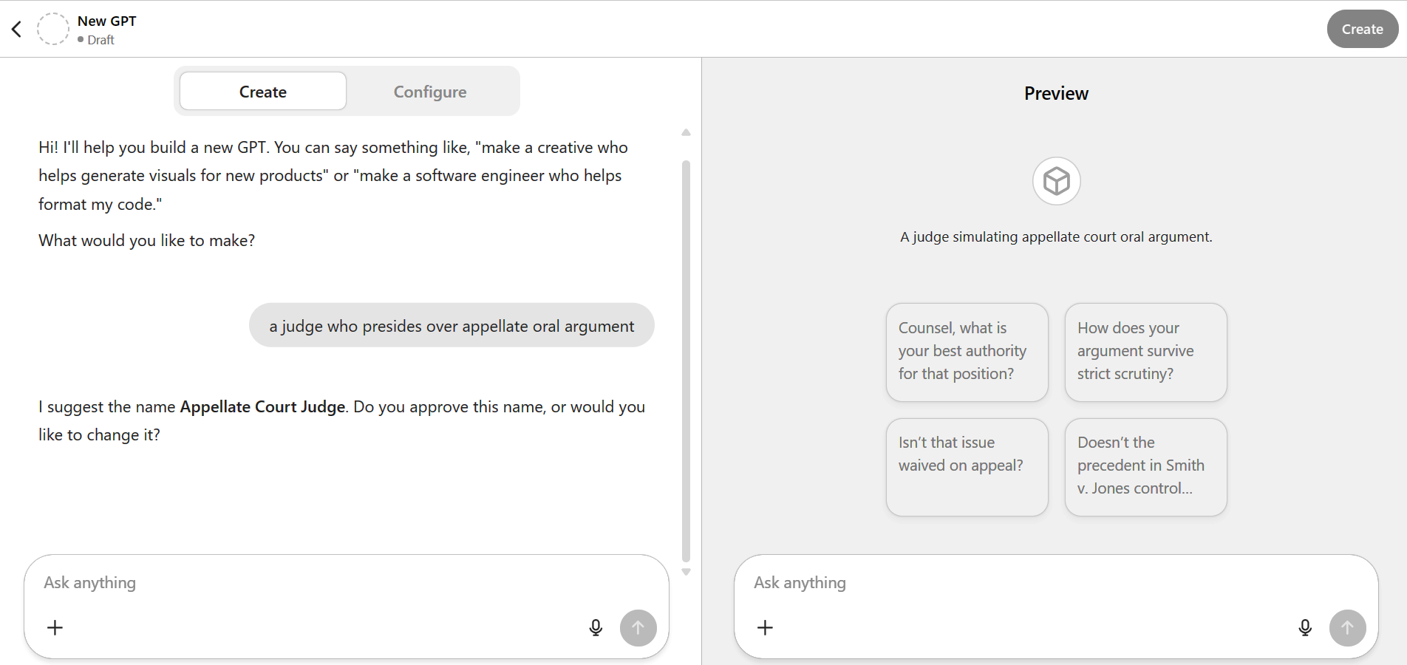
Or create your own . . .
Notes:
But, if you have a paid account, you can also create your own.

Slide 11
Notes:
I used the Judge Chat customGPT with my students this Spring, and I was pretty excited with the results. The first thing that we did was practice their summarizing and prompting skills. As you can see, to use this GPT, you must first “explain your issues and position.”

Slide 12
Prompt engineering and summarizing
Legal issue
Parties’ arguments
Procedural posture
Party you represent
Notes:
So I had students work in groups to identify what this information was and how best to present it to the AI.

Slide 13
Unified prompt
I am representing the [plaintiffs/defendant] in a First Amendment action. The plaintiffs are elementary school students who sued the defendant school district over the district's decision to move a library book titled Melanie's Marvelous Measles to the restricted section requiring parent approval for check out. The school district justified its decision by stating that the book was demonstrably false and conflicted with the district's curriculum standard regarding vaccines. The court below granted the district's motion for summary judgment, agreeing that the book was demonstrably false and that the district had discretion over curricular decisions.
Notes:
After we discussed, I then presented them with a unified prompt to ensure that their interactions with the AI covered the necessities.

Slide 14
Responses to questions
You may type or speak your responses
Notes:
The nice thing about ChatGPT is that it allowed them to either type their responses or speak them.

Slide 15
Sample argument
Notes:
Here’s a sample of what the back-and-forth looked like.

Slide 16
AI Feedback
Notes:
When the students were done, they could simply tell the AI to end the argument, and it then offered feedback that was surprisingly good. Here’s some sample positive feedback.

Slide 17
Notes:
And here’s some of the constructive feedback. The nice thing with AI is that students could use it whenever, wherever, and as often as they wanted to. But, given that this was my first time having students use this tool, I wanted to be sure they were getting good advice and feedback.

Slide 18
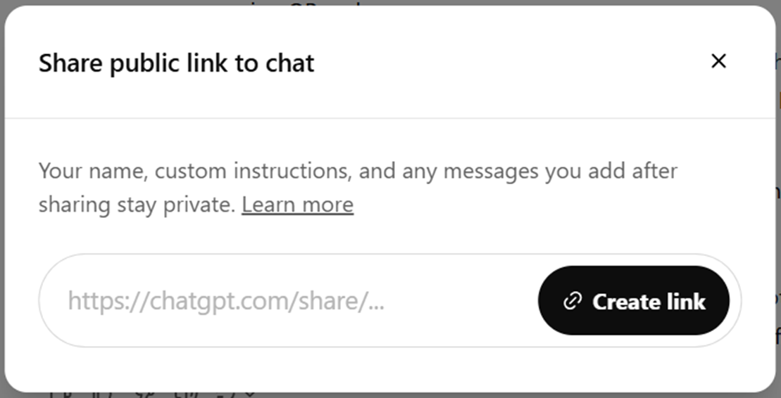
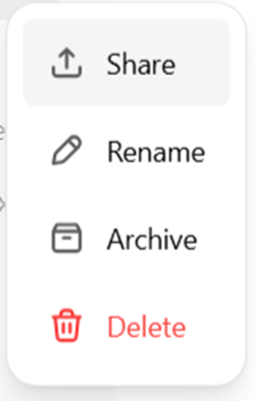
Professor Feedback
Have students email a transcript
OR
Copy/paste (using right-click or ctrl+c and ctrl+v)
Notes:
So I had them email me a transcript of their interaction for me to review and comment on. There are several ways to have them do this. They can share a link or copy/paste the conversation.

Slide 19
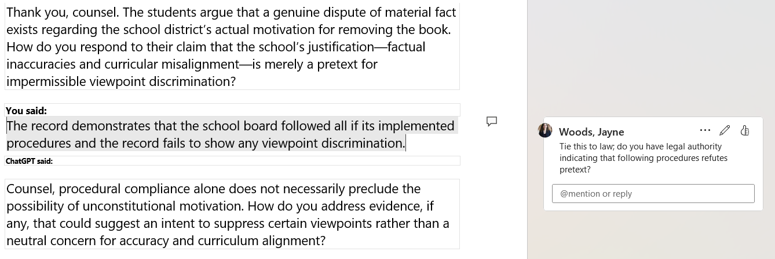
Notes:
If they sent it in a word document, I could use track changes to give feedback directly on their arguments and the AI’s responses/feedback. Here are some examples.

Slide 20
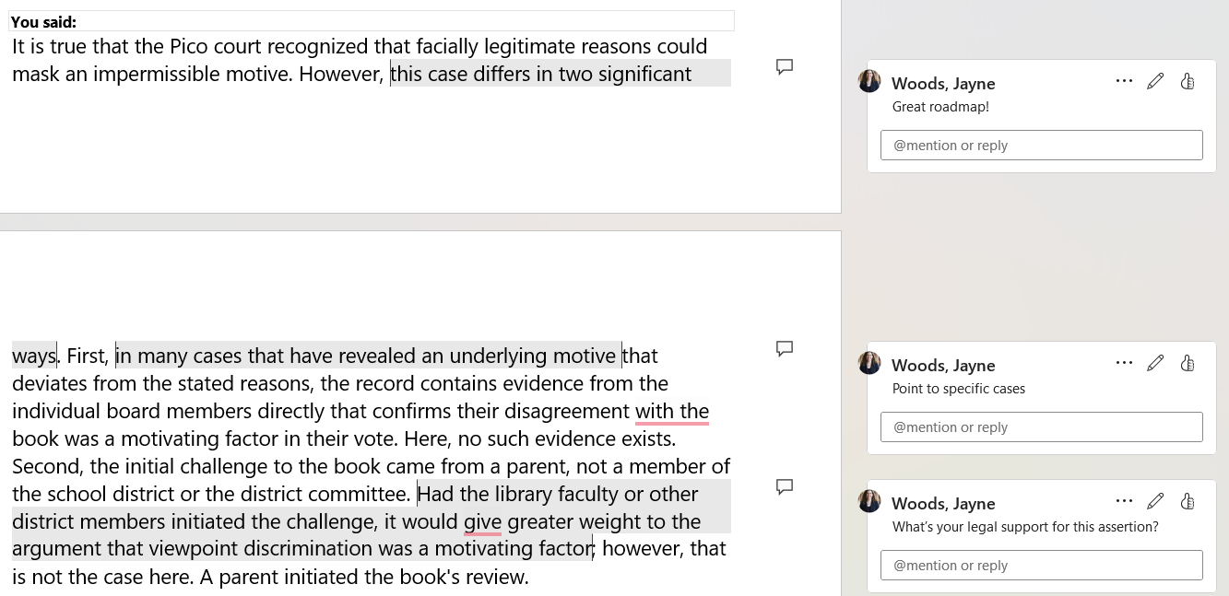

Slide 21
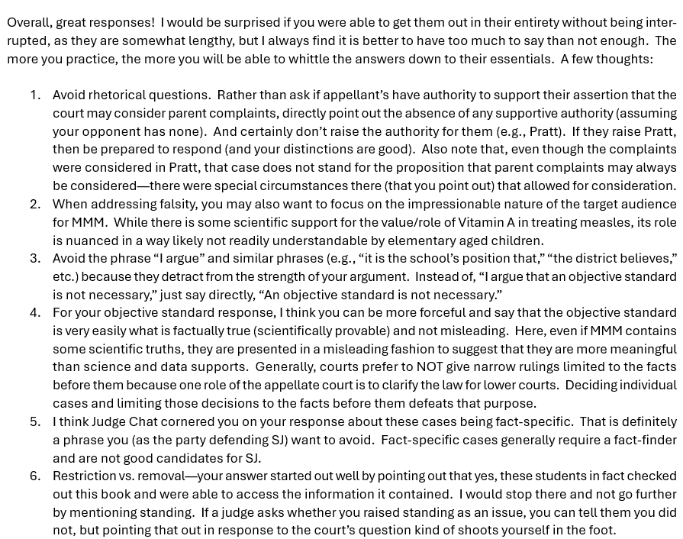
Notes:
I also was able to open a link in ChatGPT and view the conversation and then provided specific feedback by email. Under either scenario, it was my first and only opportunity to watch students actually argue and give feedback before they participated in the competition.

Slide 22
Considerations
Whether AI has access to underlying/current law
Use existing customGPT or create your own?
Usage limits
Comfort with uploading materials
Notes:
Some things to consider:
Existing customGPTs may be less helpful if the case involves state or administrative law; and with this problem specifically, the 5th Circuit just dramatically changed its position last week on one of the cases that heavily favored the students
To resolve this concern, you can explore creating your own customGPT, which many have already done
While students will need AN account, it need not be a paid account; however, they will run into usage limits with the free account. When this happened, I suggested my students input the same prompt into a different AI (I found Claude very useful) and continue practice there
You will also want to discuss with your students what materials, if any, you are comfortable with them uploading (and be willing to accept the possibility that any restrictions you give may be ignored)

Slide 23
Questions?
woodsjt@missouri.edu

