Slide 1

leveraging aI-assisted Contract Drafting for Social Good
Professor Sue Chesler
Sandra Day O’Connor College of Law, Arizona State University
June 3, 2025

Slide 2

Companies’ Commitment to Social Causes
* Altruism & the Rise of B-Corps
* Response to Stakeholder Demands

Slide 3
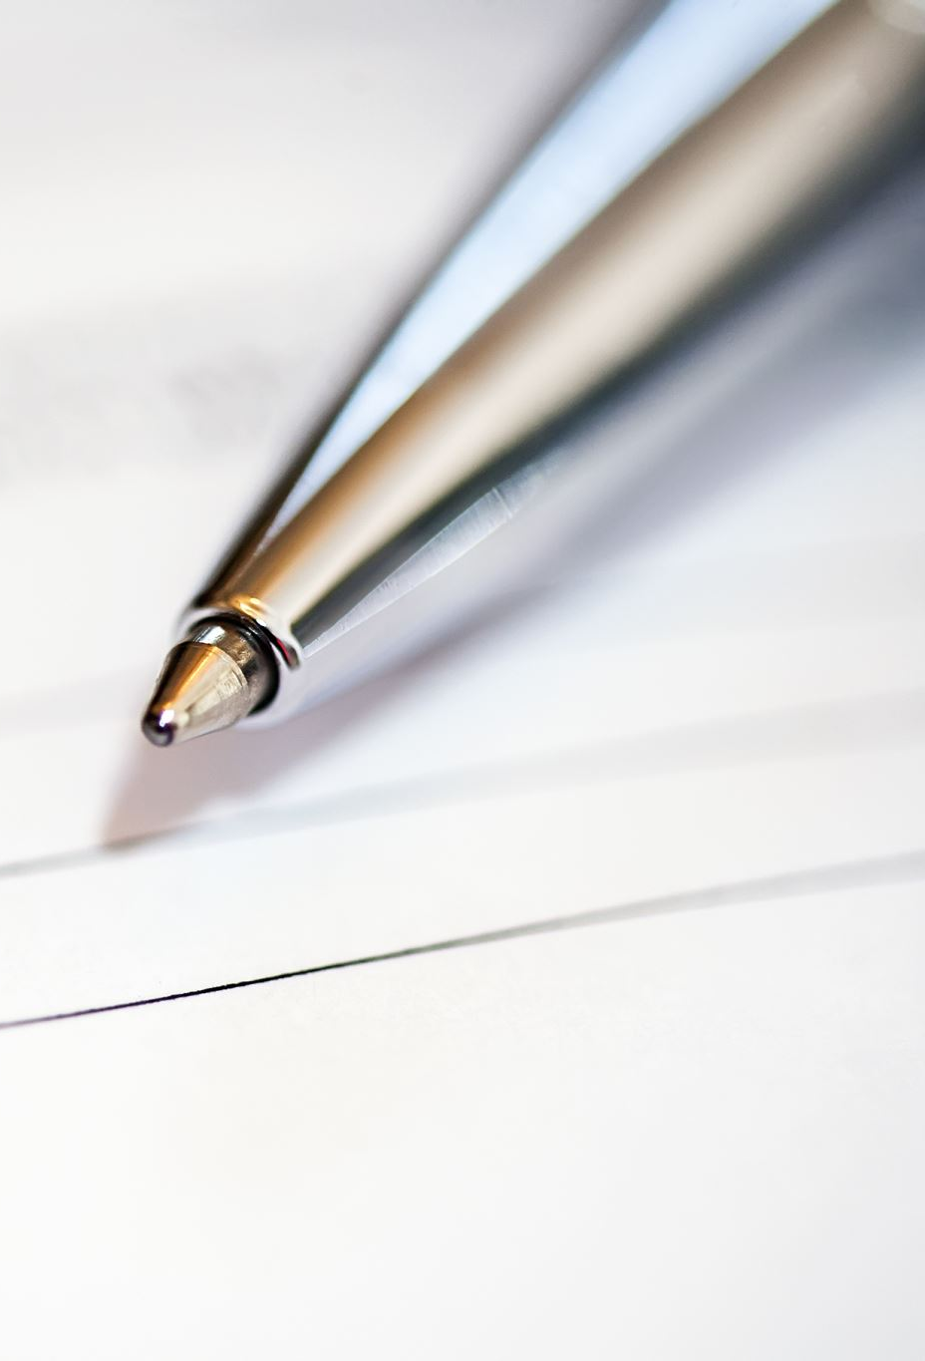
Contract drafting For social good
How can contracts be used for social good?
How can contracts be drafted to achieve those goals?
  Substance & Style
  Storytelling Techniques
What are the challenges involved?

Slide 4
AI Drafting tools to the rescue
Contract Drafting and AI are a match made in heaven.
Illustration:
  Draft a sustainable commuting clause for an employment contract.
  Can you expand on the introductory language to show how both the employer and employee are committed to environmental sustainability.

