Slide 1
J.D. Grants Funding Process
2025-2026
Last updated June 18, 2025

Slide 2
Who’s Who
Ryan Poe-Gavlinski, Chair of the JD Grants Committee
Mary Ann Polewski, JD Grants Committee Member
Carlie Wiseley, Student Life & Engagement Manager
Jennifer Gardner-Brokmeier, Law School Financial Manager & Accountant
Kevin Murphy, Law School Financial Specialist
Adam Bushcott, Main Office Manager
Heidi Johnson, Assistant Director, Scholarships & Financial Aid
General JD Grants email: jdgrants@law.wisc.edu
JD Grants Website
Notes:
There are a lot of names throughout this presentation and throughout our website and instructions you’ll be using this year. Before we get started on our presentation, let’s have a round of introductions.

Slide 3
Scope of the Committee’s Work
Co-Curricular Activities
Law Journals: WLR, WILJ, & WJLGS
Moot Court
Mock Trial
Registered Student Organizations (other than the SBA)
Individual Students

Slide 4
Criteria for Funding
Educational value for students
Number of students who benefit
Larger value to the Law School
Cost and location
Student fundraising efforts (within UW policy - see Carlie Wiseley with questions)
Complete, accurate, and timely application
* Note: The Committee has a limited budget this year.
You can view Eligibility & Criteria for Funding online

Slide 5
Funded Events
Types of Events
Travel to conferences & competitions
Local Events
Virtual Events
Examples of past events funded
Competitions (moot court, mock trial, arbitration)
Law Journal symposia
Speakers at the Law School
Pro bono service projects and trips
Law conferences
Wellness events

Slide 6
Changes in 2025-2026: Awards for Competitions
The JD Grants Committee provides competition funding for Law Students only when (1) they will earn credit for participating in the competition and (2) their participation will be supervised by a faculty member who provides guidance for their competition preparation in addition to granting credit in the course.
By default, the committee does not fund first-year students’ participation in competitions, because 1Ls cannot enroll in upper-level courses. The Assistant Dean for Student Affairs, Lauren Devine, may authorize a 1L to be considered for JD Grants funding for a competition in extraordinary and unusual circumstances.
Please review this full policy on the JD Grants Forms page

Slide 7
Important Info about Travel Awards
Funding for student travel will be distributed via Travel Awards, which are required by federal law.
If you currently receive financial aid (including scholarships, federal loans, grants, etc.) at or near your Cost of Attendance, the travel award may cause your total financial aid to exceed your COA.
Travel award recipients whose financial aid is at or near their total COA may qualify for a Budget Adjustment.
Please contact Heidi Johnson (heidi.johnson@wisc.edu) with questions about how a travel award will affect your financial aid.

Slide 8
Deadlines for Funding Requests
July 15, 2025 | Budgets from co-curricular activities and Request forms for events on or after August 25
August 15, 2025 | Budgets from student orgs that anticipate requesting more than $5,000 in 25-26 and Request forms for events on or after September 30
September 15, 2025 | Request forms for events on or after October 30
October 15, 2025 | Request forms for events on or after November 30
December 1, 2025 | Request forms for events on or after January 20, 2026
January 15, 2026 | Request forms for events on or after February 28
February 15, 2026 | Request forms for events on or after March 30
Also available on the Deadlines page of the JD Grants website

Slide 9
Overview: Steps in the Funding Process
Read the JD Grants Website
Determine whether you need to submit a budget.
Moot Court, Mock Trial & Journals MUST submit a co-curricular budget
Registered Student Organizations who might request $5,000 or more MUST submit an advisory budget
When you know the likely date of an event, determine the JD Grants deadline that you must submit your request by.
Decide which funding request form to submit. Email the completed form as a Word doc to jdgrants@law.wisc.edu
After the event, submit the appropriate post-event report. These can be found on the JD Grants Forms page.
For a detailed description of each step, please review “Steps in the JD Grants Process 2025-2026” on the JD Grants Overview page.

Slide 10
Key Points to Remember
For co-curriculars and organizations that submit a budget: You must still complete & submit request forms on time for individual events throughout the year.
Co-curriculars and student organizations must follow all UW & Law School policies pertaining to student organizations.
Instructions, including deadlines, are embedded throughout each request form and post-event reporting form. Please read carefully and ask questions when needed!

Slide 11
For a Successful Application
Know and meet deadlines
Estimate costs realistically
Submit accurate information - check your math, please!
Pursue other funding sources (within UW policy- see Carlie Wiseley with questions)
Explain the event’s educational value thoughtfully

Slide 12
I got the funding…now what?

Slide 13
…now what? Step 1: Plan
Plan your trip or event
Travel awards have a specific timeline of steps you must complete after receiving confirmation of funding. This timeline can be found in the Funding Request for Student Travel Awards form online
Save your itemized receipts as you plan your event.
Receipts must be itemized in order for the school to reimburse you!
Travel Award recipients do not need to save receipts, since these awards are disbursed through the Bursar’s Office.
If planning a local event, work with Carlie Wiseley or External Affairs to ensure you are following all UW & Law School policies
If JD Grants has funded food for a local event, you MUST have participants sign in. Be sure to include folks working the event too! Use this Hosted Meal Sign In Sheet

Slide 14
…now what? Step 1.5: Wisconsin Sales Tax
Wisconsin sales tax cannot be reimbursed.
To avoid paying unnecessary sales tax out of your own pocket:
Before you make any purchases at a store, online, or at a restaurant… Contact the Main Office Manager, Adam Bushcott (adam.bushcott@wisc.edu),to get the Law School’s tax-exempt number.

Slide 15
…now what? Step 2: Post-Event Reports
After your trip or event, complete the appropriate Actual Expenses Report:
Local Event - Local Event Actual Expenses Report (due 2 weeks after the event)
Local event with food - Law School Business Office Events Meal Payment form with participant sign in sheet
Virtual Event - Virtual Event Actual Expenses Report (due 1 week after the event)
Travel - Attendance Report for Student Travel Awards (due 1 week after the event)
If the total cost of your trip exceeds the original award by $25 or more, you may submit a Request for Supplemental Travel Award
All forms available on the JD Grants Forms page

Slide 16
…now what? Step 3: Reimbursement
For food purchases, email Adam Bushcott (adam.bushcott@wisc.edu) with the following:
Event description
List of people who attended the event
Meal Payment Form
Name & email of person(s) to be reimbursed
Itemized receipts
For non-food purchases, email Adam Bushcott with the following:
JD Grants Decision Letter/email
Event description
Business Purpose
Name & email of person(s) to be reimbursed
Itemized receipts
Notes:
In the next few slides, we’ll break down what each of these items are and explain some common mistakes.

Slide 17
Reimbursement (cont.)
Meal Payment Form
Attendance List
Remember, if you are serving food, you MUST take attendance or have a sign in sheet
Agenda and/or Event Announcement
email to students (SBA Announcement counts)
Flyer

Slide 18
Reimbursement (cont.)
A Receipt must be provided for reimbursement and must include:
Business name
Date
Itemized purchases
A credit card receipt is not acceptable! You may only use the credit card receipt to show the tip in addition to the itemized receipt.

Slide 19
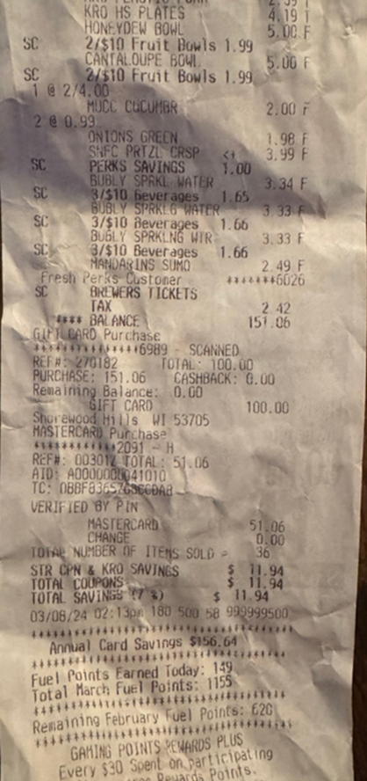
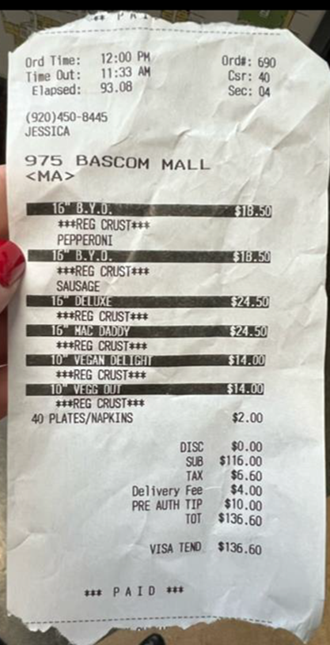
Receipts - what NOT to do
Notes:
The receipt on the left, I can see what was purchased, but I don’t know the name of the business. The receipt on the right, again, this is not a picture of the full receipt. If you’re having trouble getting a good picture of a receipt, try scanning it.

Slide 20
Reimbursement (cont.)
A Business Purpose must be provided.
Not acceptable: “Lunch during 7+ hour training event for new members”
Acceptable: “The Wisconsin Law Review held its New Member Orientation on August 25th. This orientation was a full day and included a provided lunch break for the students. During the orientation, the new members learned about the WLR, introduced themselves to the Board and associates, and were trained on how things work in the WLR office. After the orientation, new and current members met at the Memorial Union Terrace for a Meet & Greet.”

Slide 21
To conclude…
JD Grants Website is updated for 2025-26, including:
Overview & Steps in the Process
Funding Criteria
Deadlines
Forms
Got Questions? Ask! jdgrants@law.wisc.edu

