Slide 1
Bluebooking Tips for the Write-on & Beyond
Bonnie Shucha
UW Law Library
Spring 2012

Slide 2
Citations in the Text

Slide 3
According to the U.S. Department of Labor, over 21,000 legal jobs were lost during 2009, with January and February alone recording a loss of five thousand.

Slide 4
According to the U.S. Department of Labor, over 21,000 legal jobs were lost during 2009, with January and February alone recording a loss of five thousand.
Geographical abbreviation
Rule 6.1

Slide 5
According to the U.S. Department of Labor, over twenty-one thousand legal jobs were lost during 2009, with January and February alone recording a loss of five thousand.
Number
Rule 6.2

Slide 6
The employer should recognize the dignity of the firm members, “not...look[ing] upon them as their bondsmen.¹”

Slide 7
The employer should recognize the dignity of the firm members, “not . . . look[ing] upon them as their bondsmen.¹”
Ellipsis dots
Rule 5.3

Slide 8
The employer should recognize the dignity of the firm members, “not . . . look[ing] upon them as their bondsmen.¹”
Alterations in quotes
Rule 5.2

Slide 9
The employer should recognize the dignity of the firm members, “not . . . look[ing] upon them as their bondsmen.”¹
Placement of footnotes
Rule 1.1

Slide 10
Citations in Footnotes

Slide 11
Leslie A. Gordon, The Economic Crisis: Law Firms Brace for Rocky 2009, 35 San. Fran. Att’y 17, 17 (2009); Michael Yoder, President’s Page: Our Profession’s Déjà Vu, 51 J. of Business L. 7, at 7 (2009).

Slide 12
Leslie A. Gordon, The Economic Crisis: Law Firms Brace for Rocky 2009, 35 San. Fran. Att’y 17, 17 (2009); Michael Yoder, President’s Page: Our Profession’s Déjà Vu, 51 J. of Business L. 7, at 7 (2009).
Multiple citations
Rule 1.3

Slide 13
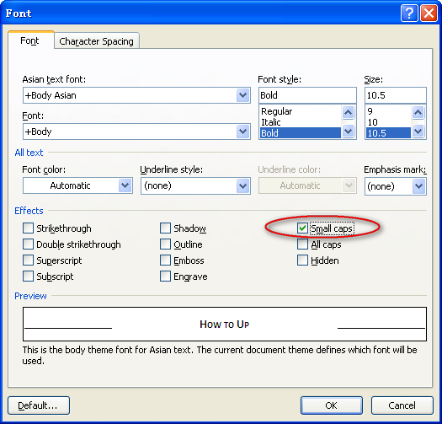
Small Caps

Slide 14
Leslie A. Gordon, The Economic Crisis: Law Firms Brace for Rocky 2009, 35 San. Fran. Att’y 17, 17 (2009); Michael Yoder, President’s Page: Our Profession’s Déjà Vu, 51 J. of Business L. 7, at 7 (2009).
Periodicals, Author Typeface
Rule 16.2

Slide 15
Leslie A. Gordon, The Economic Crisis: Law Firms Brace for Rocky 2009, 35 S.F. Att’y 17, 17 (2009); Michael Yoder, President’s Page: Our Profession’s Déjà Vu, 51 J. Bus. L. 7, at 7 (2009).
Abbreviations
Tables 13, 10

Slide 16
Leslie A. Gordon, The Economic Crisis: Law Firms Brace for Rocky 2009, 35 S.F. Att’y 17, 17 (2009); Michael Yoder, President’s Page: Our Profession’s Déjà Vu, 51 J. Bus. L. 7, 7 (2009).
Pinpoint pages
Rules 3.2, 16.4

Slide 17
Questions?
For a Bluebook tutorial,
see Interactive Citation Workstation
by LexisNexis at
http://www.lexisnexis.com/icw/

